Slide 1
Marine Leader Development (MLD): Coaching and Counseling
Lejeune Leadership Institute
September 2017
Leadership Doctrine
(703).784.9753
(703).432.5519

Slide 2
LEADING MARINES
“The Marine Corps’ vision of leading is less concerned with rank, self-identity, recognition, or privilege than with the essence of our Corps: the individual Marine and the unyielding determination to persevere because Marines and the Corps do not fail. Our vision of leading is linked directly to our common vision of warfighting, which needs leaders devoted to leading, capable of independent and bold action, who are willing and eager to assume new and sometimes daunting responsibilities, willing to take risks – not because they may succeed, but because the Corps must succeed.”
- FMFM 1-0

Slide 3
AGENDA
Brief
A Brief History
Effective Coaching
Tools
Group Discussions
AAR

Slide 4
A Brief History

Slide 5
A BRIEF HISTORY
Where Have We Been?
Counseling NAVMC 2795
Evaluating MCO 1610.7F
Mentoring MCO 1500.58

Slide 6
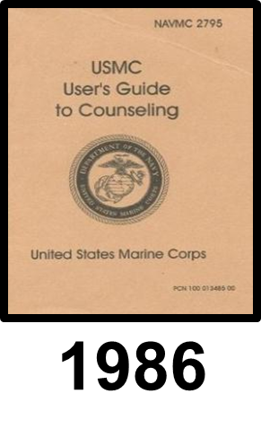
COUNSELING - NAVMC 2795
Purpose: Provides a means to assist Marine leaders and their Marines to be continuously motivated toward more effective individual performance
Creating an ingrained counseling ethic
Emphasizes the teacher-scholar, father-son relationship
Effective means of communication and understanding between senior and junior
Improve Marine Corps readiness

Slide 7
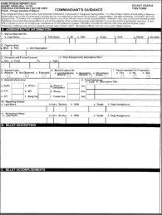
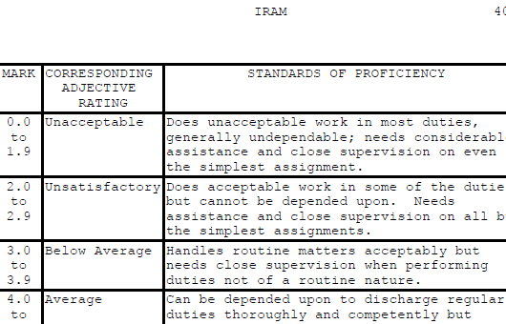
EVALUATING - MCO 1610.7F
Purpose: Supports the centralized selection, promotion, and retention of the most qualified Marines of the Active and Reserve Components; aids in the assignment of personnel and personnel management decisions as required
FitRep is primary means for evaluating a Marine's performance
Proficiency and Conduct marks record the Marine’s performance
Designated period of observation
Based on Marine Corps standards
Not a counseling document

Slide 8
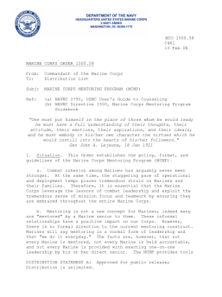
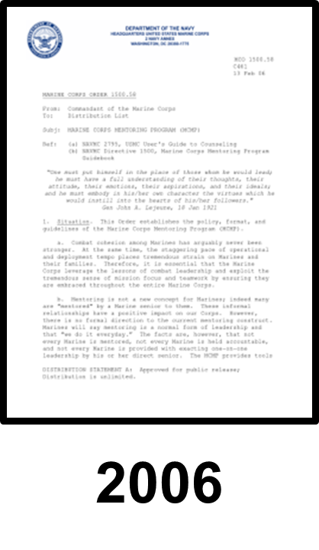
MENTORING - MCO 1500.58
Purpose: Connect leaders and their Marines and to develop the leadership qualities of junior Marines and leaders, enabling them to assume progressively greater responsibilities for themselves, each other, and to the Marine Corps
Preserve and protect the force
Support readiness
Set goals to improve personal and unit performance
2006

Slide 9
A BRIEF HISTORY
Where Have We Been?
Counseling NAVMC 2795
Evaluating MCO P1610.7F
Mentoring MCO 1500.58
Where Are We Going?
Coaching MCO 1500.61
Counseling NAVMC 2795
Evaluating MCO 1610.7F

Slide 10
COACHING DEFINED
Coaching: A process of on-going observation and encouragement of a Marine’s personal and professional growth
Part of daily operations
Provides feedback on an informal basis
Sets, documents, and communicates goals
Focused on development
NOT part of a Marine’s evaluation

Slide 11
COUNSELING DEFINED
Counseling: A process of two-way communication between a senior and a junior to help the junior achieve or maintain the highest possible level of performance
Supports and reinforces good performance
Corrects deficiencies
Transmits guidance and standards
Provides direction to subordinate development
Shapes future performance

Slide 12
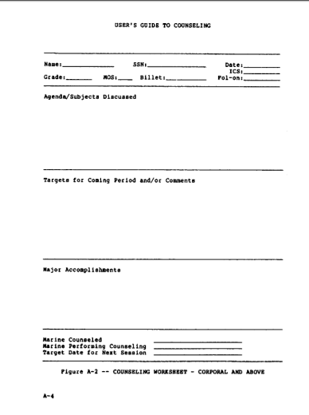
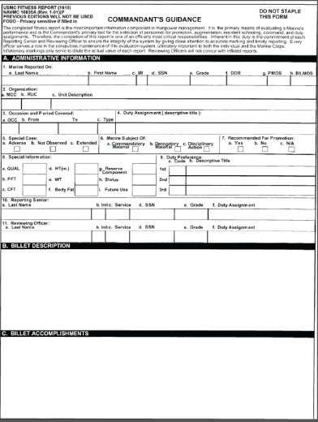
COUNSELING VS EVALUATION
VS

Slide 13
MENTORING DEFINED
Mentoring: Voluntary developmental relationship that exists between a person of greater experience and a person of lesser experience that is characterized by mutual trust and respect
Less formal than coaching and/or counseling
Often occurs outside the chain of command
Initiated by either senior or subordinate
Endure beyond tour of duty
Important source of encouragement and perspective

Slide 14
DISCUSSION GROUPS
“Coaching”-
What’s In It For Me?

Slide 15
Effective Coaching

Slide 16
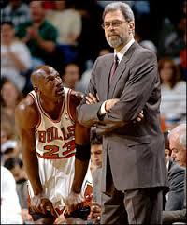
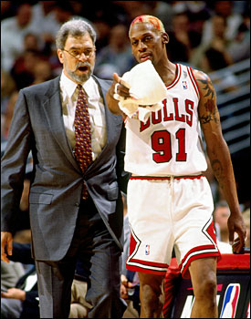
EFFECTIVE COACHING
Phil Jackson
Bulls 1989-1998
Lakers 1999-2004
2005-2011
11 NBA Championships
Highest Win Percentage
NBA Hall of Fame
Top 10 Greatest NBA Coaches

Slide 17
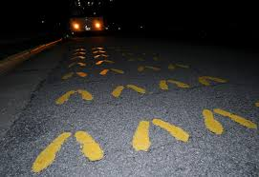

Slide 18
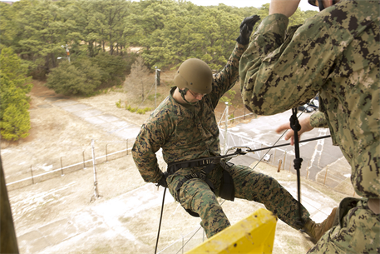
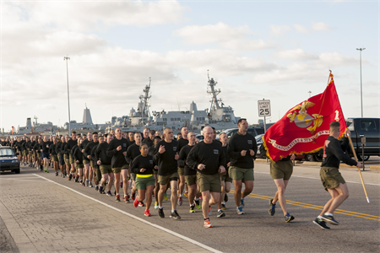
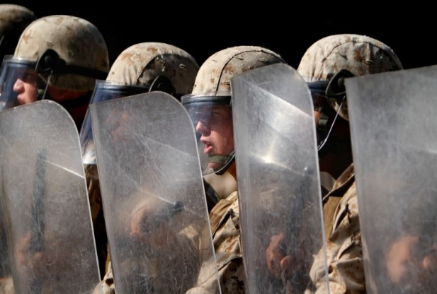
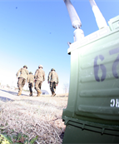
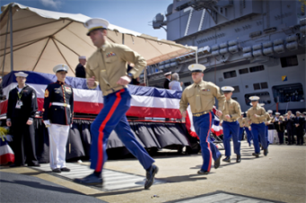
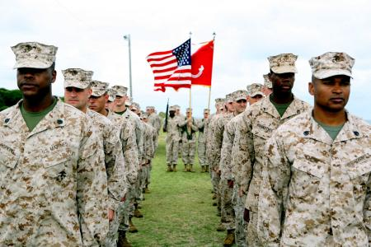
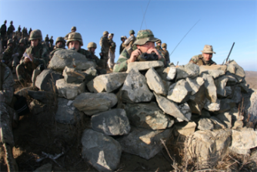
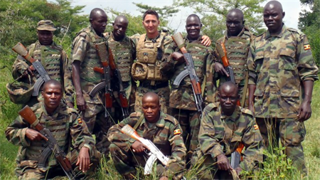
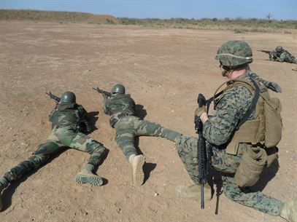
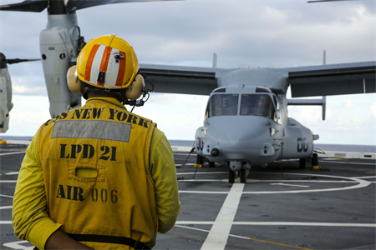
IDEAL vs REALITY

Slide 19
EFFECTIVE COACHING
Balance between ideal and reality
Creates and communicates goal/vision and individual roles and responsibilities
Understands own coaching style
Gets team to believe in the vision and themselves
Understands and develops the individual first and the skill second
Understands the game and how to prepare/train
Honest and trustworthy
Approachable and humble
Passionate about the game

Slide 20
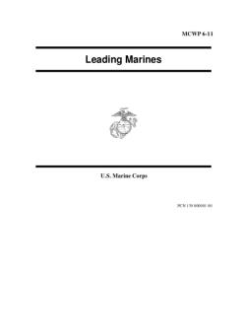
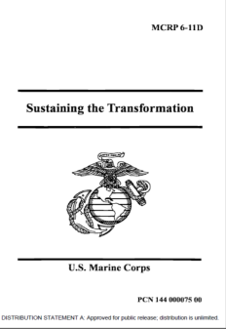
EFFECTIVE COACHING
Core Values
11 Leadership Principles
14 Leadership Traits
Officer/Enlisted Oaths
NCO/SNCO Creeds
PME and Reading Lists
1997
1995
1999

Slide 21
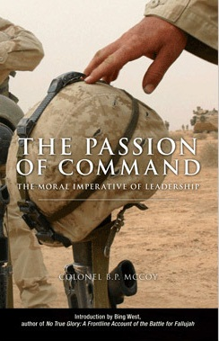
EFFECTIVE COACHING
“Under the attribute of coaching and mentoring skills, you will find judgment, justice, tact, and unselfishness as well as the leadership principle of knowing your people and looking out for their welfare. It is no more complicated than this. But, it is indispensable to breaking down barriers and making common cause with your people – and winning their hearts and minds.”
- Col B.P. McCoy
CO 3/4, 2002-2004

Slide 22
BREAKING DOWN BARRIERS
“Relations among all leaders should be based on honesty and frankness regardless of disparity between grades… Seniors must encourage candor among subordinates and must not hide behind their grade insignia.”
- MCDP 1
Possible Existing Barriers:
Rank Billet
Age Personality
Interests Gender
Marital Status Children
Race Family Dynamics
Notes:
Get team to believe in vision and selves
Keep game in perspective
Develop the athlete and the person
Understand their players
Communicators
Understand the game
Passionate about what they do

Slide 23
ESTABLISHING TRUST
“Trust is a product of confidence and familiarity.”
- MCDP 1
How do we establish and build trust?
Confidence: Demonstrated professional skill
Reliable/Dependable
Knowledgeable
Judgment
Familiarity: Shared experience and a common professional philosophy
Train as a Team
Keep Your Marines Informed
Develop a sense of responsibility
Notes:
Get team to believe in vision and selves
Keep game in perspective
Develop the athlete and the person
Understand their players
Communicators
Understand the game
Passionate about what they do

Slide 24
SETTING GOALS
“Regardless of the sphere in which we operate, it is essential to have some vision of the result we want and how we intend to shape the action in time and space to achieve it.”
- MCDP 1
Characteristics of Goals:
Specific: The goals must be clear
Measurable: Check progress and hold accountable
Attainable: Relevant, manageable, and challenging
Realistic: Tools and abilities to accomplish
Timely: Provides focus and accountability

Slide 25
EFFECTIVE COACHING
“When we ‘make Marines,’ we make Marines for life, we provide our nation with a legacy of productive citizens, transformed by their experiences while on active duty and enriched by their internalization of our ethos, ideals, and values.”
MCRP 6-11D
Transformed Marine
+
__________________________________
=
Returning (Quality) Citizen
Notes:
Get team to believe in vision and selves
Keep game in perspective
Develop the athlete and the person
Understand their players
Communicators
Understand the game
Passionate about what they do

Slide 26
DISCUSSION GROUPS
Jordan vs Rodman

Slide 27
Tools

Slide 28
TOOLS
“Equipment is useful only if it increases combat effectiveness.”
MCDP 1
First Counseling/Coaching Form
Second/Subsequent Coaching Form
Second/Subsequent Counseling Form

Slide 29
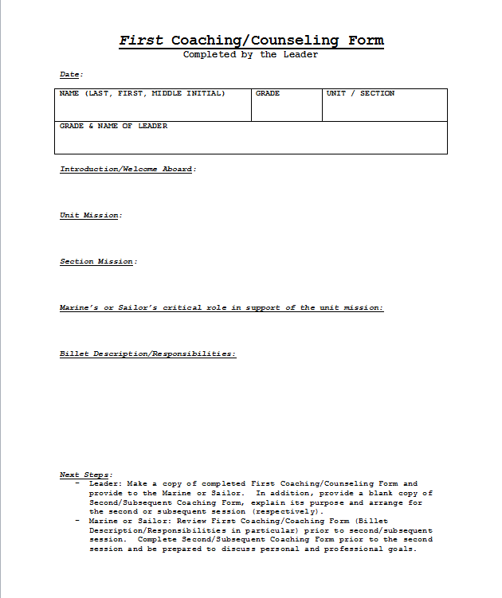
FIRST FORM
Purpose: Establish rapport between leader and coached/ counseled setting conditions for success
Completed by Leader prior to meeting
Conducted within 15 days of established relationship – ALL RANKS
Establish Formal Billet Description
Next Step: Second / Subsequent meetings

Slide 30
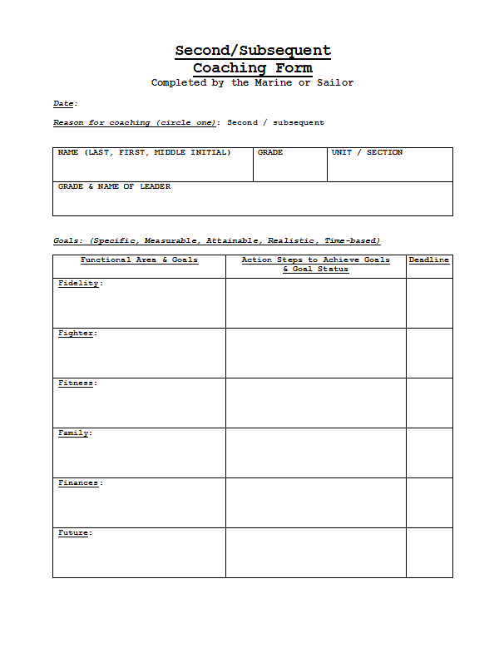
COACHING FORM
Purpose: Help the Marine establish goals and provide feedback on an informal basis
Completed by Marine/ Sailor prior to meeting
Second
Pvt-LCpl Within 30 days
Cpl-Gen Within 90 days
Subsequent
Pvt-LCpl Every 30 days
Cpl-Gen Every 180 days
May occur more frequently, as necessary

Slide 31
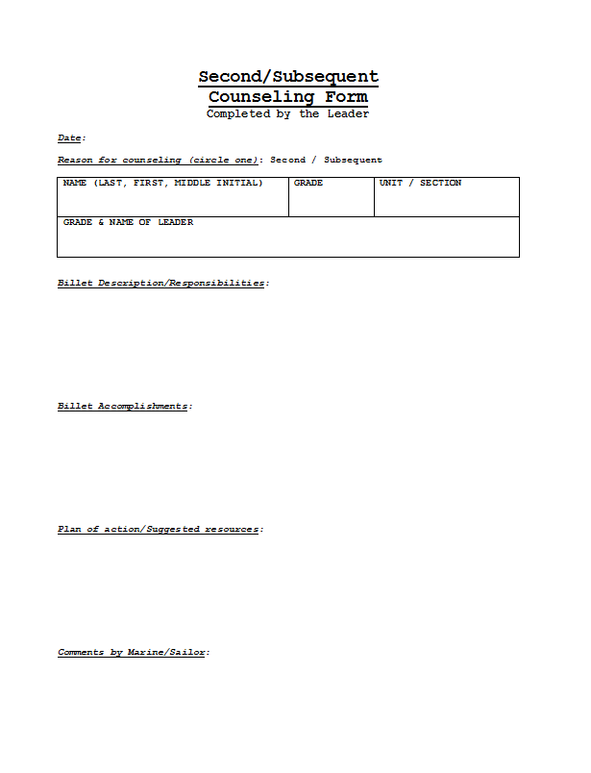
COUNSELING FORM
Purpose: Formalize or review billet description, document billet accomplishments, and ensure Marine is on-track for success
Completed by Leader prior to meeting
Second
Pvt-LCpl Within 30 days
Cpl-Gen Within 90 days
Subsequent
Pvt-LCpl Every 30 days
Cpl-Gen Every 180 days
May occur more frequently, as necessary

Slide 32
EFFECTIVE MEETING
“Planning plays as important a role in the preparation for war as it does in the conduct of war.”
- MCDP 1
PREPARE FOR IT

Slide 33
LEADING MARINES
“The Marine Corps’ vision of leading is less concerned with rank, self-identity, recognition, or privilege than with the essence of our Corps: the individual Marine and the unyielding determination to persevere because Marines and the Corps do not fail. Our vision of leading is linked directly to our common vision of warfighting, which needs leaders devoted to leading, capable of independent and bold action, who are willing and eager to assume new and sometimes daunting responsibilities, willing to take risks – not because they may succeed, but because the Corps must succeed.”
- FMFM 1-0

Slide 34
DISCUSSION GROUPS

